Slide 1
NYC Benefits and Programs
&
NYC City Council
Data
Catherine Baisley

Slide 2
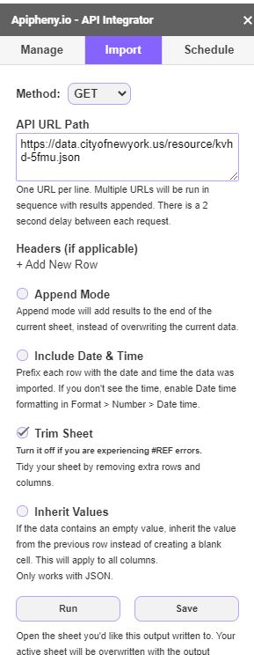
Data Extraction
APIs taken from NYC Open Data
https://data.cityofnewyork.us/resource/kvhd-5fmu.json &
https://data.cityofnewyork.us/resource/aabe-yfm9.json
Apipheny add-on Google Sheets
Downloaded as CSV
Uploaded in Jupyter Notebook with Pandas

Slide 3
Data Summarization
Benefits and Programs
List of 102 benefits and programs available to NYC residents
Every benefit and program is ran by a government agency for specific groups of people
API created 4/26/2019 and updated weekly
Dataset includes program categories, population served, and summary descriptions
https://data.cityofnewyork.us/Social-Services/Benefits-and-Programs-API/kvhd-5fmu
City Council
Oversee NYC functions such as human services, infrastructure, and government affairs
Every committee has Chair Council Member with a minimum of 5 members and meets minimum of once per month
API created 1/1/2018 and updated weekly
Dataset includes names of each member with their committee, starting date, and ending date
https://data.cityofnewyork.us/City-Government/NYC-City-Council-Committee-Membership/aabe-yfm9

Slide 4
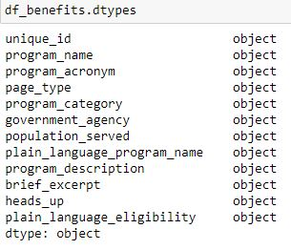
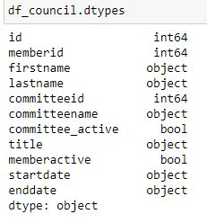
Data Cleaning
Two csv files Jupyter Notebook Python 3
Deleted columns and timestamp with unnecessary information
Benefits and Programs dataframe = qualitative 102 rows x 12 columns City Council dataframe = mainly qualitative 402 rows x 11 columns

Slide 5
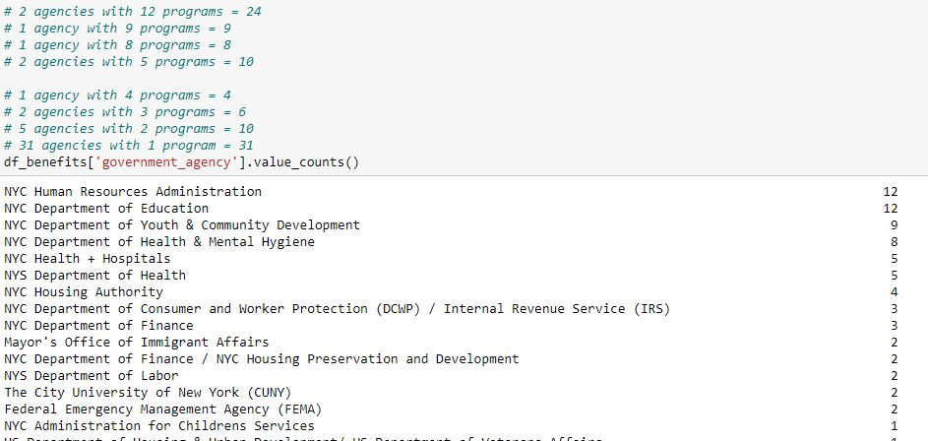
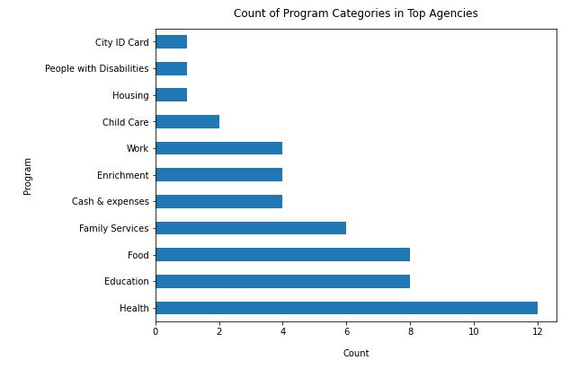
Data Exploration
Benefits and Programs
Only took top 6 agencies

Slide 6
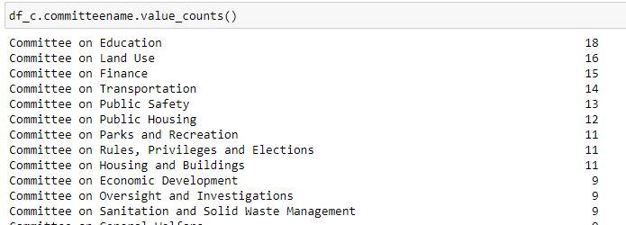
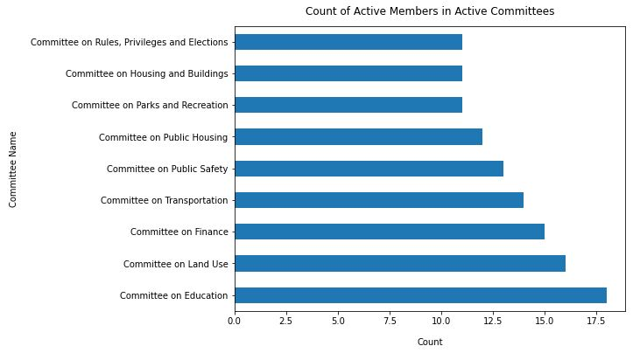
Data Exploration
City Council
Only took committees with 10+ members

Slide 7
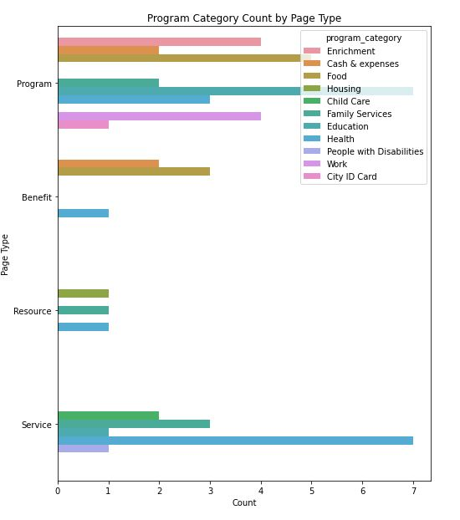
Diving Deeper
Benefits and Programs
Certain program categories only exist in one page types which includes; Enrichment, Housing, Child Care, People with Disabilities, Work, and CIty ID Card
Some programs exist in two categories such as; Cash & expenses, Food, and Education
Two programs exist in three categories which are Family Services and Health

Slide 8
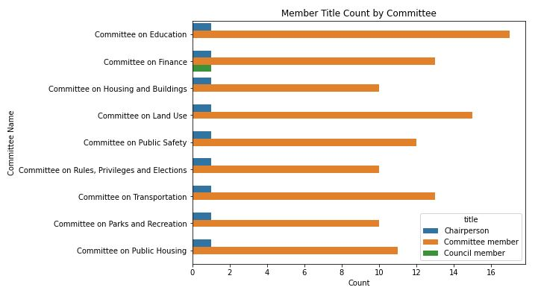
Diving Deeper
City Council
There is only one council member in the top nine most populated committees
Education is the most populated
In the education committee 15 out of the 17 started on 1/11/2018. One started on 6/13/2019 and the other started on 10/30/19

Slide 9
Overall Findings
13% of NYC agencies produce 50% of the benefits and programs. These six agencies include; NYC Department of Education, NYC HR Administration, NYC Department of Youth & Community Dev, NYC DOHMH, NYC Health & Hospitals, NYS DOH, NYC Health and Hospitals, and NYS DOH
The top 6 agencies create a variety of different programs but mainly focus on Health, Education, and Food. Of these three programs they are available to the NYC public through services, resources, benefits, and programs. There are programs for all different groups of people for example; HIV/AIDS Services Administration for anyone with HIV/AIDS that lives in NYC
Majority of committees are active, committees that are no longer active include; Committee on Juvenile Justice, Committee on For-Hire Vehicles, Subcommittee on Planning, Dispositions and Concessions, Subcommittee on Landmarks, and Public Siting and Maritime Use
There are 5 active Council members in committees (90k base salary) they belong to Economic Development (2), Finance, Sanitation and Solid Waste Management, and Environmental Protection

